Slide 1
Ordination of flow cytometry data

Slide 2
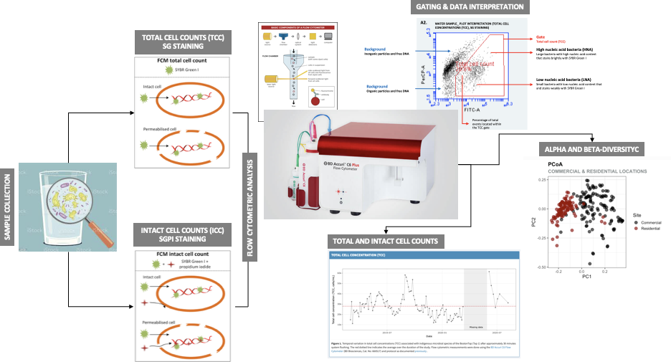
FC primer
Notes:
https://labtestsonline.org/flow-cytometry

Slide 3
Ordination
^ id and visually
Objective: Reduce dimensions to represent associations and improve the interpretability of data.
In other words, to take high dimensional data, remove noise, and retain signal of the data in order to gain insight of hidden structures and patterns.
In other words, to capture dominant sources of variation in the data.
Notes:
Ordination is a collective term for multivariate techniques which summarize a multidimensional dataset in such a way that when it is projected onto a low dimensional space, any intrinsic pattern the data may possess becomes apparent upon visual inspection (Pielou, 1984).
In ecological terms: Ordination summarizes community data (such as species abundance data: samples by species) by producing a low-dimensional ordination space in which similar species and samples are plotted close together, and dissimilar species and samples are placed far apart. Ideally and typically, dimensions of this low dimensional space will represent important and interpretable environmental gradients.
Generally, ordination techniques are used in ecology to describe relationships between species composition patterns and the underlying environmental gradients (e.g. what environmental variables structure the community?). Two very important advantages of ordination is that 1) we can determine the relative importance of different gradients and 2) the graphical results from most techniques often lead to ready and intuitive interpretations of species-environment relationships.

Slide 4
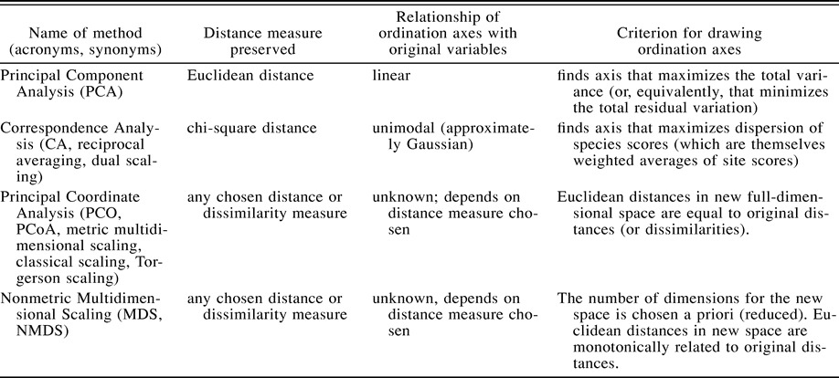
Types
Exploratory ~Indirect gradient analysis ⇔ unconstrained (simple) ordination
Visualizing broad patterns across the entire data cloud. Also, for cases in which data are classified into a priori groups, one can visualize potential patterns of differences in the location or relative dispersion among groups.
https://doi.org/10.1890/0012-9658(2003)084[0511:CAOPCA]2.0.CO;2

Slide 5
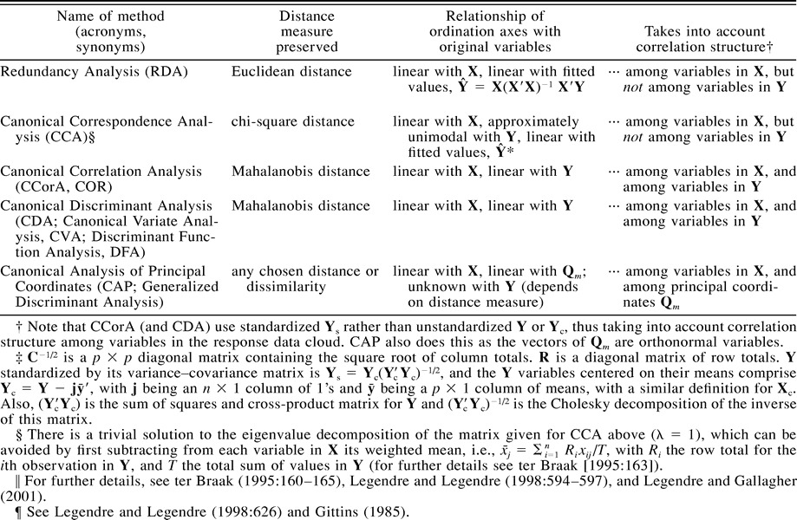
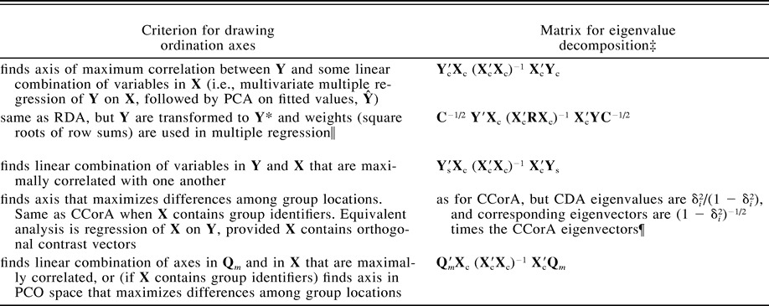
Types (continued)
Hypothesis driven ~ Direct gradient analyses ⇔ constrained (canonical) ordination
Use an a priori hypothesis in some manner to produce the plot. That is, they can be used to relate a matrix of response variables, Y (species abundance variables) with some predictor variables, X (such as quantitative environmental variables or dummy variables that identify ANOVA factors or groups).
https://doi.org/10.1890/0012-9658(2003)084[0511:CAOPCA]2.0.CO;2
Notes:
https://esajournals.onlinelibrary.wiley.com/doi/full/10.1890/0012-9658%282003%29084%5B0511%3ACAOPCA%5D2.0.CO%3B2?saml_referrer

Slide 6
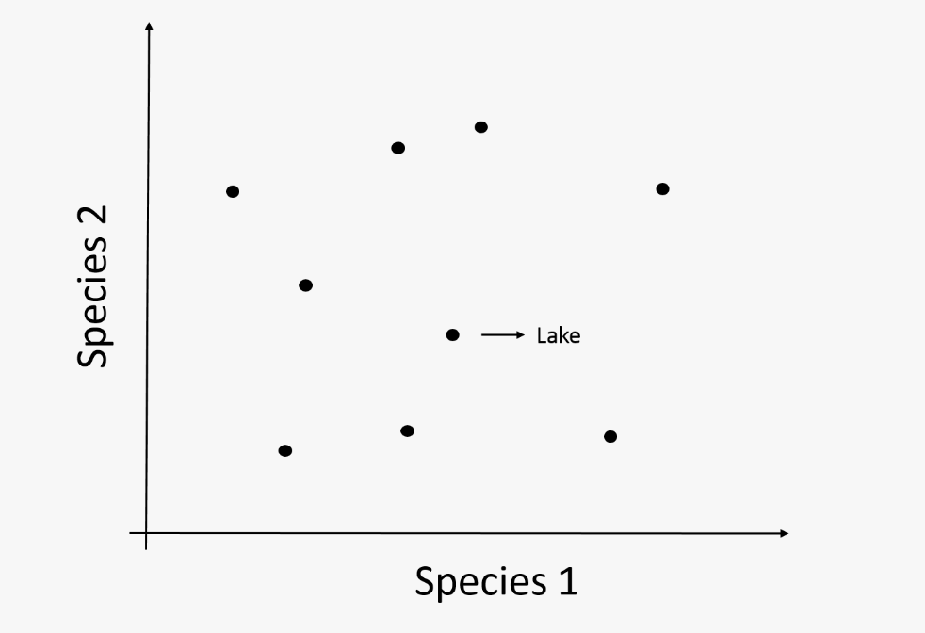
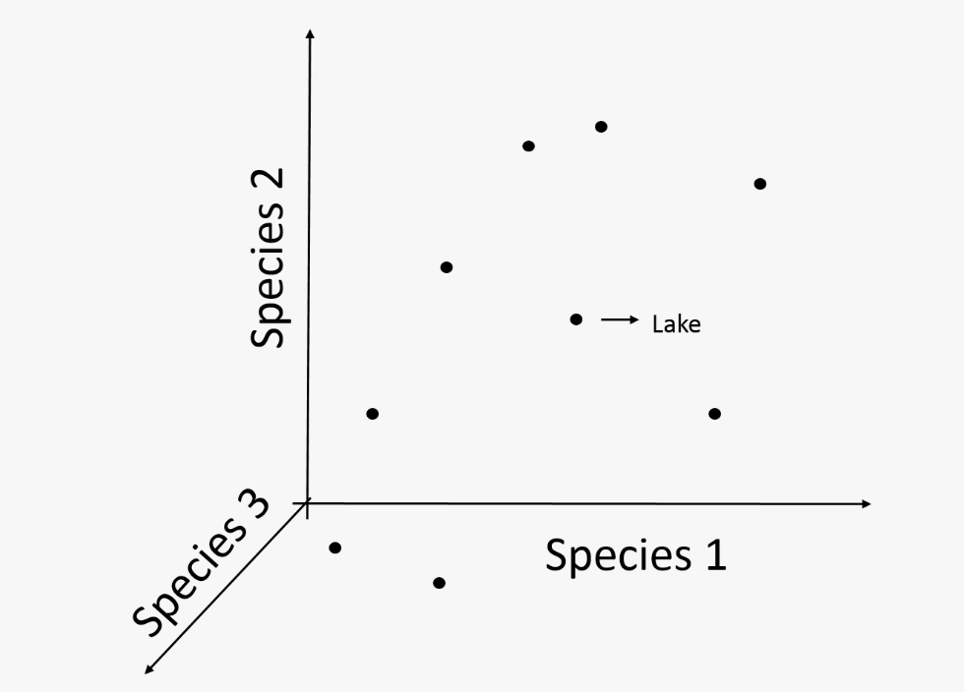

Unconstrained ordination
2 variables
3 variables
4 variables +
Notes:
Variance: measure of dispersion from its mean
Co-variance: measure of co-dispersion of variableS from their means
Correlation: strength of linkage between variables
Eigenvalues: proportion of variance (dispersion) represented by one ordination axe
Loadings: → features
Orthogonality: right angle → independent variables, not correlated
Score: site * feature (results from subtracting value from feature mean, across all sites → linear combination with PC values for each site by all centered features → new coordinates for each site (x -->PC1, y-->PC2)
Dispersion: inertia, measure of total variability of descriptors in the multidimensional space respective to center of gravity
https://builtin.com/data-science/step-step-explanation-principal-component-analysis

Slide 7
Principal Component Analysis (PCA)
2D representation of community composition OR response variables
Preserves EUCLIDEAN distance
PC
new variables
maintain a LINEAR relationship between ordination axes and original variables
uncorrelated
most of the information within the initial variables is squeezed or compressed into the first components.
Notes:
linear combinations or mixtures of the initial variables

Slide 8
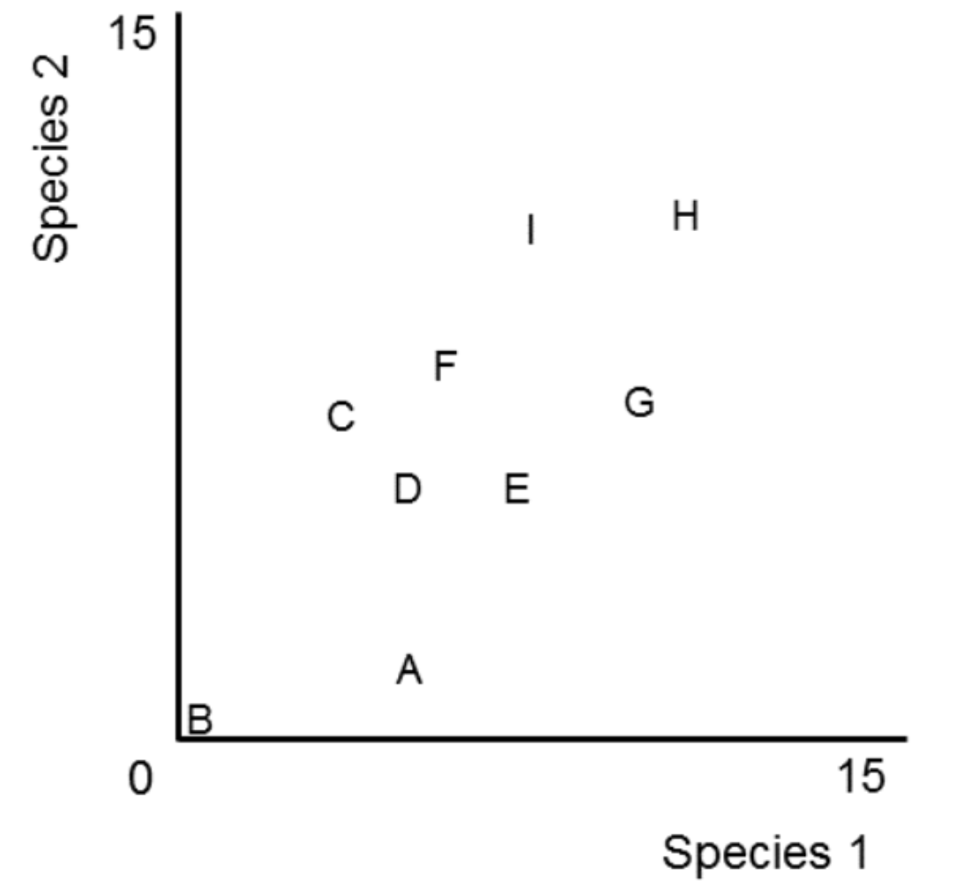
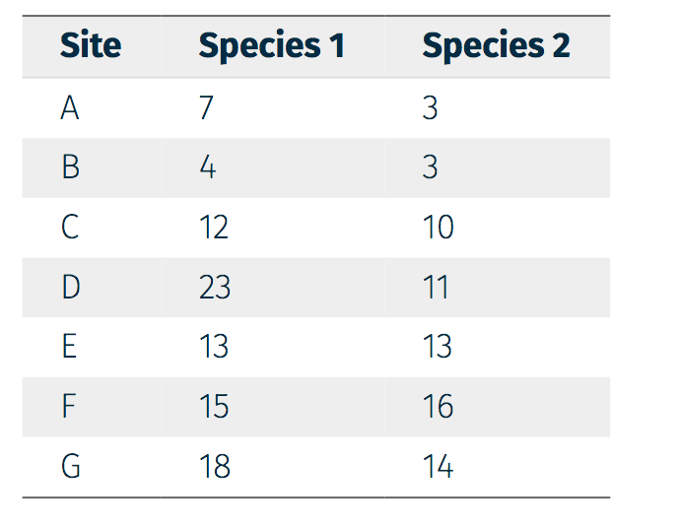
PCA construction
Feature 2
Site
Feature 1
Feature 2
Feature 1

Slide 9
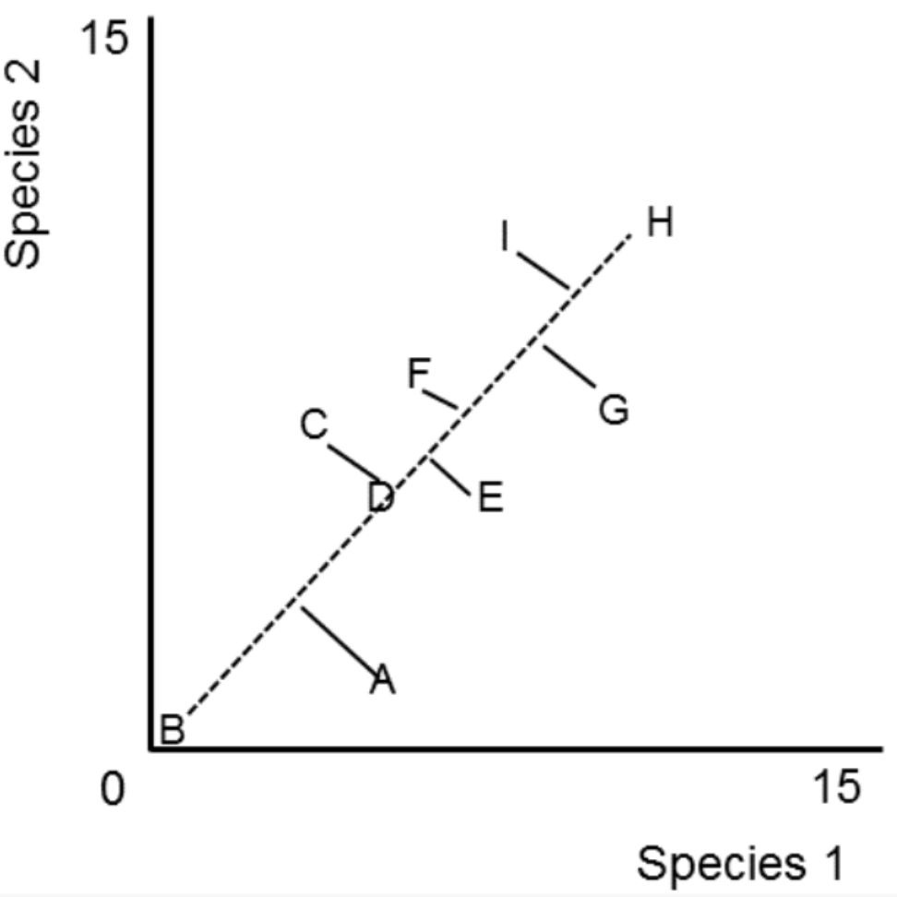
PCA construction
Drawing the first component:
Origin (standardization)
Best fit (maximum variation observed)
Feature 2
Feature 1

Slide 10
PCA construction
Drawing the first component:
Origin (standardization)
Best fit (maximum variation observed)
Feature 2
Feature 1

Slide 11
PCA construction
Drawing the first component:
Origin (standardization)
Best fit (maximum variation observed)
Feature 2
Feature 1

Slide 12
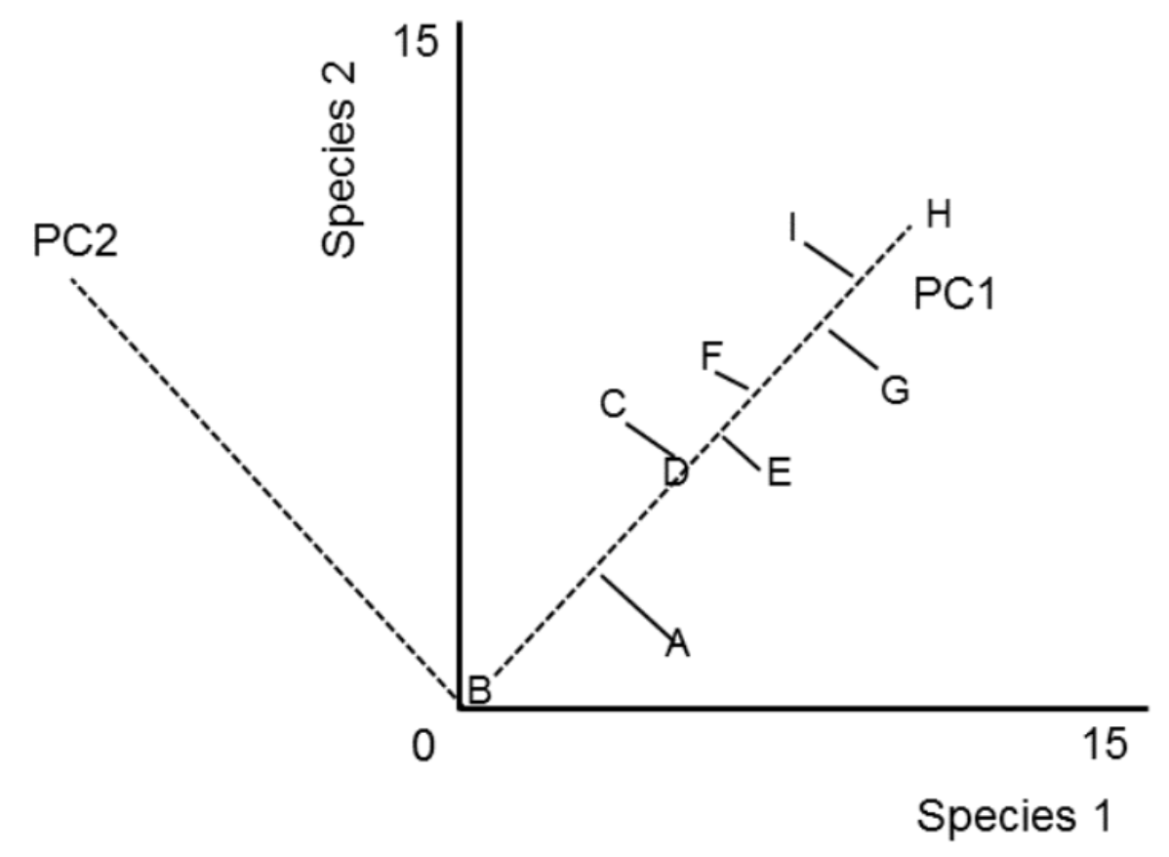
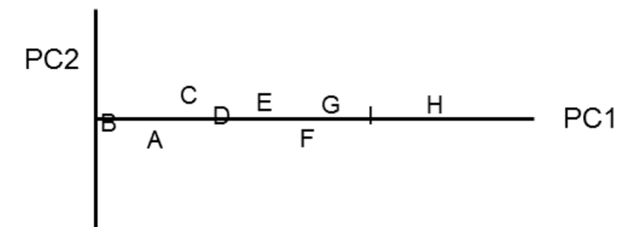
PCA construction
Drawing the second component:
Perpendicular to first axis
Rotate
In the multidimensional case:
As many PCs as there are variables (dimensions)
All PC axes are orthogonal
Ranked based on the variance they explain
Feature 2
Feature 1

Slide 13
Eigen analysis
Square matrix (covariance (or correlation) matrix)
Computation of eigenvalues and eigenvectors (always in pairs)
Eigenvector → direction, rotation to new axes
Eigenvalue → value that represents variance in the eigenvector, how much stretching needs to be done
The eigenvector with the highest eigenvalue is the first principal component.

Slide 14
Principal Coordinate Analysis (PCoA aka metric multidimensional scaling)
Preserve distances in multidimensional space → (Dis)similarity matrix as input
Aim at producing a graphical representation in a low dimensional (2D or 3D) Euclidean space such that the distances between points are as close to the original distance as possible.
Choice of dissimilarity relative to data/question.
Generally PCA is used to summarize multivariate data into as few dimensions as possible, whereas PCoA can be used to visualize distances between points
Notes:
PCoA starts by putting the first point at the origin, and the second along the first axis the correct distance from the first point, then adds the third so that the distance to the first 2 is correct: this usually means adding a second axis. This continues until all of the points are added.
But how do we get back down to 2 dimensions? Well, simply do a PCA on these constructed points. This obviously captures the largest amount of variation from the n-1 dimensional space.

Slide 15
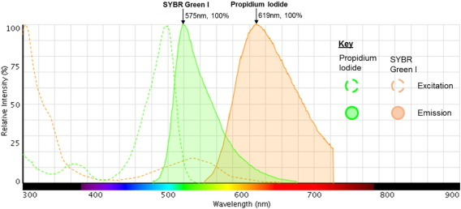
Notes:
https://www.sciencedirect.com/science/article/pii/S0167701217300465#f0005

Slide 16
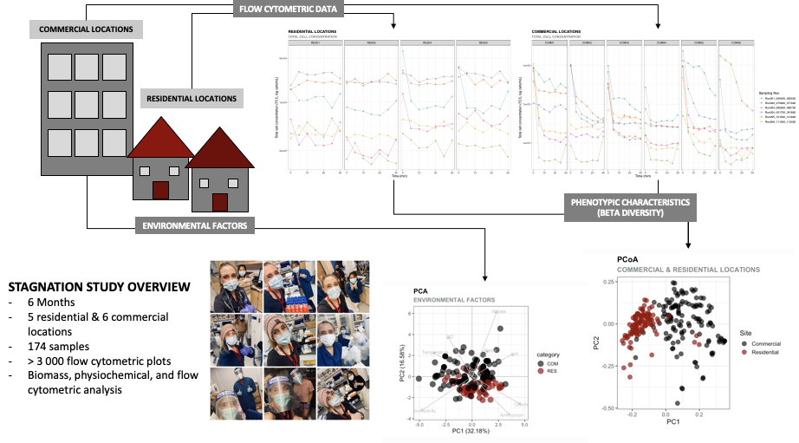

Slide 17

Practical
Data input
Data exploration
Pre-processing
PCA
PCoA
Notes:
https://www.ncbi.nlm.nih.gov/pmc/articles/PMC6586259/pdf/pcbi.1006907.pd

Slide 18
https://www.davidzeleny.net/anadat-r/doku.php/en:ordination
http://www.umass.edu/landeco/teaching/multivariate/readings/LegendreandGallagher2001.pdf
http://www.umass.edu/landeco/teaching/multivariate/schedule/ordination1.pdf
http://www.umass.edu/landeco/teaching/multivariate/schedule/ordination2.pdf
https://fukamilab.github.io/BIO202/06-A-unconstrained-ordination.html
https://fukamilab.github.io/BIO202/06-B-constrained-ordination.html#key_points
https://esajournals.onlinelibrary.wiley.com/doi/full/10.1890/0012-9658%282003%29084%5B0511%3ACAOPCA%5D2.0.CO%3B2?saml_referrer

